Slide 1
Introduction
Design patterns make it easier to reuse successful designs and architectures.
Benefits
Reusable
Avoid alternate that compromise reusability
“Right”, faster
Make documentation easy
Make maintenance easy

Slide 2
What is design pattern?
"Each pattern describes a problem which occurs over and over again in our environment, and then describes the core of the solution to that problem, in such a way that you can use this solution a million times over, without ever doing it the same way twice” by Christopher Alexander.
These are not templates that one can use it.
This is descriptions of communicating objects and classes that are customized to solve a general design problem in a particular context.
some patterns can be expressed more easily in one language than the other

Slide 3
Essential Elements for pattern
Pattern name: This is a handle we can use to describe a design problem, its solutions, and consequences in a word or two.
Problem: When to apply and explain problem and its context.
Solution: It describes the elements that make up the design, their relationships, responsibilities, and collaborations.
Consequences: These are the results and trade-offs of applying the pattern. These are important for understanding the costs and benefits of applying the pattern.

Slide 4
Classifying Design pattern
On basis of Purpose
Creational : Creational patterns are used to create objects for a suitable class that serves as a solution for a problem.
Structural : Structural patterns are concerned with how classes and objects are composed to form larger structures.
Behavioral :describe interactions between objects and focus on how objects communicate with each other.
On basis of Scope
Class
Objects

Slide 5

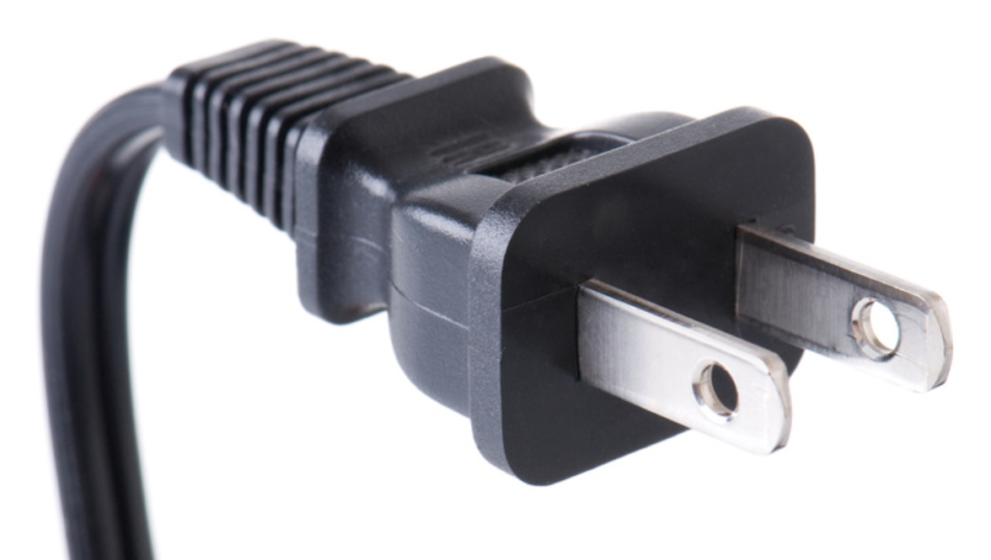
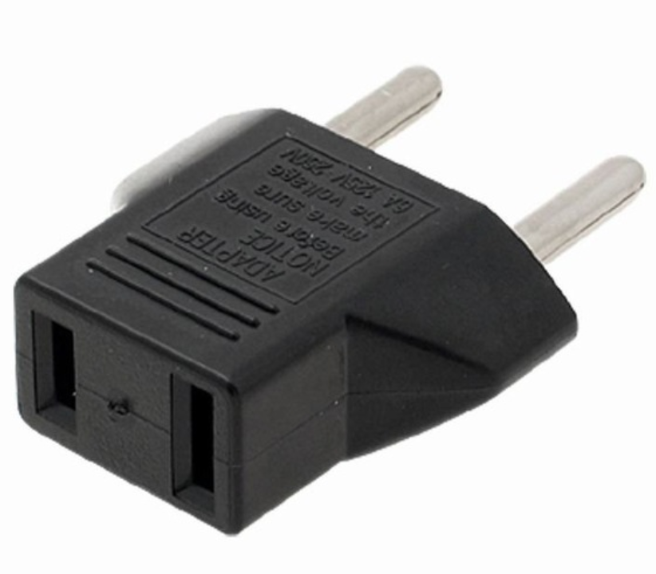
1- ADAPTER(Structural)
A switchboard can only use round pin sockets; however, we have a flat switch. What to do now?
Solution

Slide 6
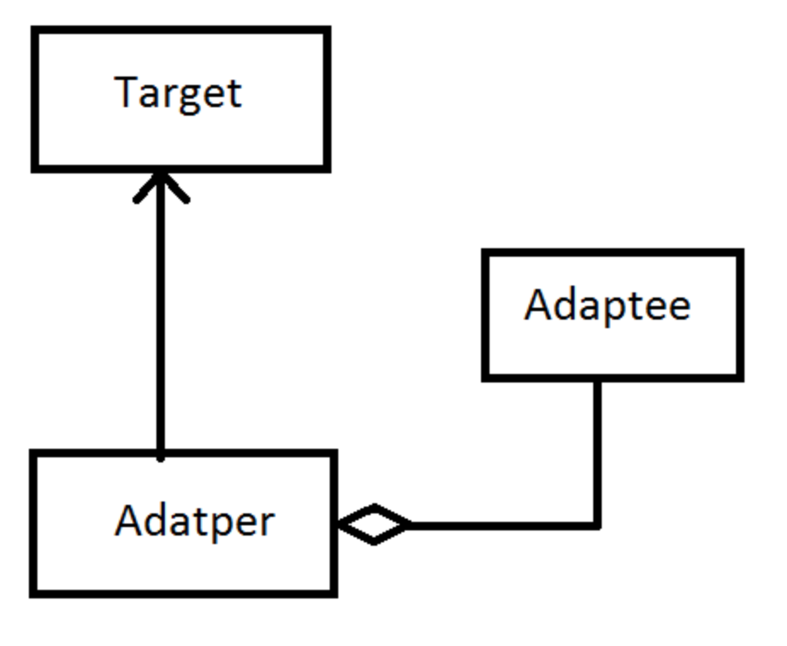
1- ADAPTER(Structural)
Adapter has an adaptee
Adapter is a Target

Slide 7
1- Adapter
Adapter pattern works as a bridge between two incompatible interfaces.
This pattern involves a single class which is responsible to join functionalities of independent or incompatible interfaces

Slide 8
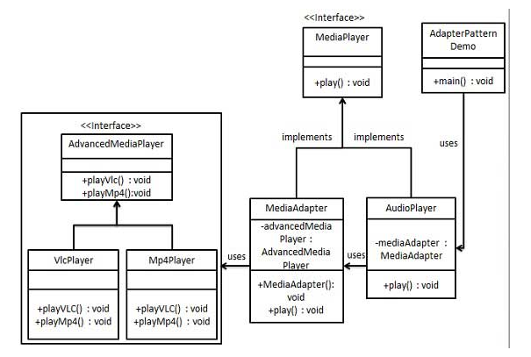
Media Player Example Adapter

